Slide 1

Quest 101: Supercomputing at Northwestern
June 26, 2024
Slides are here:
https://github.com/nuitrcs/Quest101
Haley Carter, Computational Specialist
Matthew Gorby, Senior Computational Specialist

Slide 2

Research Computing and Data Services
We're here to help after the workshop!
quest-help@northwestern.edu
bit.ly/rcdsconsult
https://sites.northwestern.edu/researchcomputing/

Slide 3

Who are you?
Graduate student?
Like to code in R?
Like to code in python?
Wish your favorite coding language got as much attention as those other two?
Work with “bioinformatics”?
Used Quest before?

Slide 4
Quest 101: Supercomputing at Northwestern
What is Quest?
What resources are available?
How do I get access?
How do I log on?
How do I navigate the file system and where should I store things?
Command line tutorial
Software modules available on Quest
Submitting jobs
writing a job script
interactive jobs

Slide 5
Quest 101: Supercomputing at Northwestern
Browser-based options for interacting with Quest
Quest OnDemand
Quest Analytics Nodes
What if the software I need isn’t already a module?
Conda virtual environments
Docker and singularity containers
Time for questions

Slide 6
What is Quest?

Slide 7
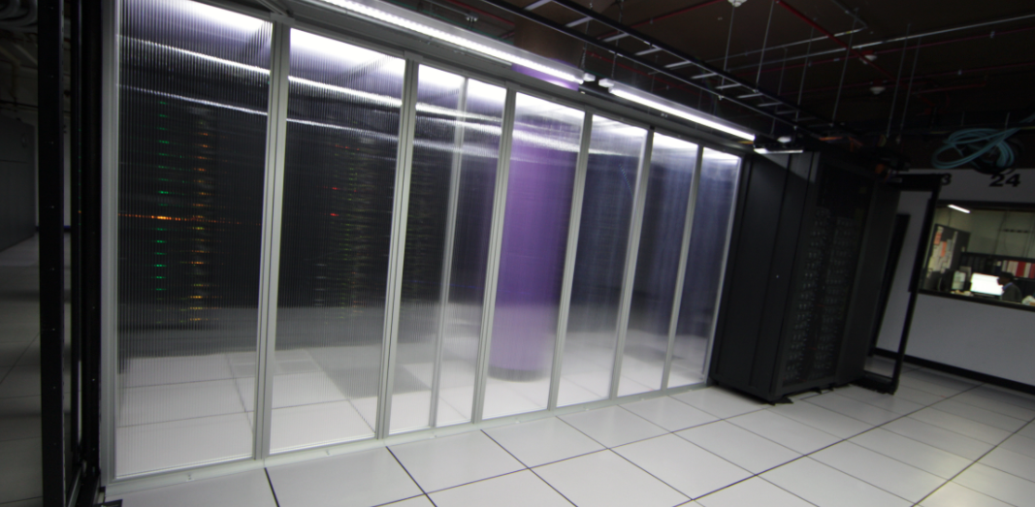
Quest!

Slide 8

Simplified Quest Architecture
Power
Cooling
Specialty: GPU & high memory
Load Balancer
Q9
Q10
Q12
Q12
Analytics
Infiniband (Fast Networking)
GPFS
Login
Q9
Q10
Q10
Q11
Q12
Scheduler, Globus,
Backup, Logger,
Management, etc
Compute Nodes
Users
Storage
File-Servers

Slide 9
Simplified Quest Architecture
Power
Cooling
Specialty: GPU & high memory
Load Balancer
Q9
Q10
Q12
Q12
Analytics
Infiniband (Fast Networking)
GPFS
Login
Q9
Q10
Q10
Q11
Q12
Scheduler, Globus,
Backup, Logger,
Management, etc
Compute Nodes
Users
Storage
File-Servers

Slide 10

Technical Specifications of Nodes Vary
There are several generations of nodes!
Generation | # cores per node | Total memory | Memory per core
Q9 | 40 | 192 GB | ~4.8 GB
Q10 | 52 | 192 GB | ~3.7 GB
Q11 | 64 | 256GB | ~4GB
Q12 | 64 | 256GB | ~4GB
96
532
208
212
Q9
Q10
Q11
Q12
Notes:
Note that you can’t use the FULL memory – 180G for the 192G, 84G for the 96G

Slide 11
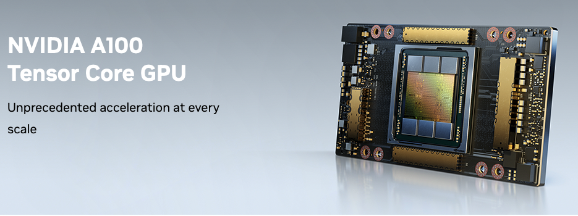
General Access Specialty Nodes
12 nodes x2 40GB NVIDIA A100 GPUs.
16 nodes x4 80GB NVIDIA A100 GPUs.
One High Memory Node with 1.5TB of RAM.
https://www.nvidia.com/en-us/data-center/a100/

Slide 12
Domain and School Specific Resources

Slide 13

Genomics Compute Cluster A special account funded by Feinberg & Weinberg to support bioinformatics/genomics research at Northwestern
37 quest11 nodes (2,368 cores total)
70 quest10 nodes (3,640 cores total)
6 quest9 nodes (240 cores total)
2 nodes x4 40GB NVIDIA A100 GPUs
5 high memory quest11 nodes – 2TB RAM per node
~650TB of shared scratch space
Learn more about the GCC!

Slide 14
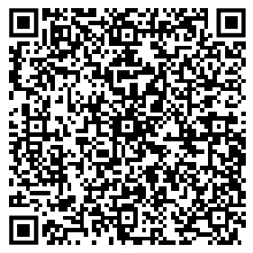
The Kellogg Linux Cluster (KLC)
The Kellogg Linux Cluster (KLC) is a group of 10 high-memory nodes each which has 1.5 - 2.0 TB of RAM.
Networked storage is shared among all the KLC servers. This includes a private 80 GB home directory for each user and 600 TB of network storage available for project directories, where you can share files with each other.
Learn more about the KLC!

Slide 15
How do I get access to these resources? Become a member of a Quest Allocation

Slide 16
What is an Allocation?
Project group that allows you to do research and submit jobs on Quest
Gives you storage /projects folder
Compute Resources
Shared workspace with collaborators

Slide 17
Different Types of Allocations
General access
Research I
1TB of storage
general access partitions
Research 2
2TB of storage
general access partitions
Classroom
2TB of storage
general access partitions
Buy-in
custom amount of storage, $195/TB for 5 years
custom compute resources, buy-in partition
Genomics Compute Cluster (free)
up to 40TB scratch storage space per user
genomics partitions

Slide 18
What type of allocation do I need?
1. Is this for research or coursework?
Coursework......................................................................................Classroom Allocation.
Research..........................................................................................go to Question 2.
2. Does my research group have an existing allocation?
Yes...................................................................................................Join existing allocation.
No....................................................................................................go to Question 3.
3. Do I need more than 100,000 CPU hours per year or 1TB of data storage?
Yes...................................................................................................go to Question 4.
No....................................................................................................Research Allocation I.
I have no idea....................................................................................Research Allocation I.
4. Do I need more than 500,000 CPU hours per year or more than 2TB of data storage?
Yes...................................................................................................Buy-in Allocation.
No....................................................................................................Research Allocation II.
5. Am I working with sequencing data?
Yes................................................................................you may also apply to join the GCC.
No.................................................................................do not apply to join the GCC.

Slide 19

How to Obtain an Allocation?
Join an existing research allocation
Create a new research allocation by submitting a form
https://www.it.northwestern.edu/departments/it-services-support/research/computing/quest/general-access-allocation-types.html

Slide 20



Our Adventure Through Quest
Compute
nodes
Login nodes
Submit
jobs
Log in
Scheduler
(“Slurm”)
User
Storage

Slide 21

Let’s open the Terminal…

Slide 22
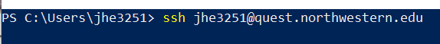
If you are using Terminal...
Command: ssh <Net ID>@quest.northwestern.edu
Password will be your Net ID’s password

Slide 23
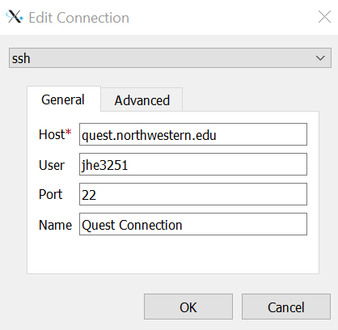

If you are using FastX3…
Host: quest.northwestern.edu
User: Your NetId
Port: 22
Name: Anything you would like!
More on FastX3

Slide 24
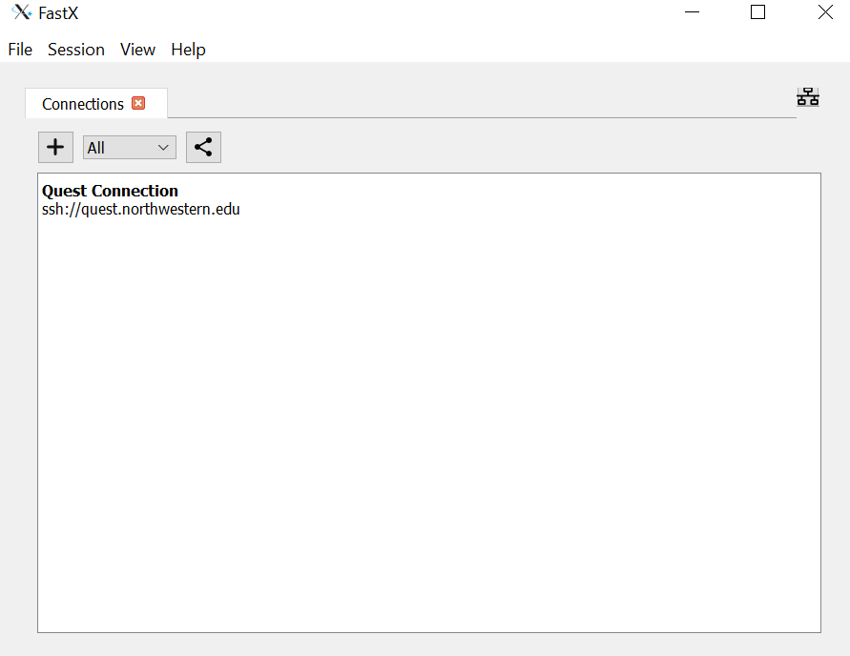
If you are using FastX3…
Double-click the connection you just created
More on FastX3

Slide 25
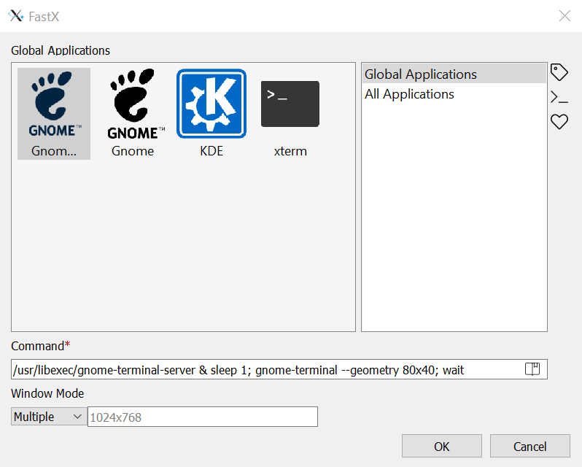
If you are using FastX3…
Select Gnome
More on FastX3

Slide 26
Our Adventure Through Quest
Compute
nodes
Login nodes
Submit
jobs
Log in
Scheduler
(“Slurm”)
User
Storage

Slide 27

I logged in! But now where am I? ...File Systems

Slide 28


C:\Users\ritika\Documents\my_project\data.csv
PC (Windows)
c:
Program Files
Users
System
ritika
guest
Documents
Desktop
Music
Photos
dissertation
my_project
data.csv
process.py
DRAFT.docx

Slide 29
/Users/ritika/Documents/my_project/data.csv
MacOS and Linux
/
Applications
Users
System
ritika
guest
Documents
Desktop
Music
Photos
dissertation
my_project
data.csv
process.py
DRAFT.docx

Slide 30
How do I access files and folders on Quest?
Operating system on Quest is Linux (rhel 7.9)
When you log in, you will be in your home directory
File system is shared across all computers on Quest
You can access your files & folders from anywhere
You will be working with 3 main folders:
/home/<netid> ← your personal home directory
/projects/<alloc-id> ← your project/allocation directories
/scratch /<netid> ← 5TB of temporary (30 day) storage)

Slide 31
How do I access files and folders on Quest?
/
home
projects
hsc945
<yourNetID>
job_scripts
R
environment_files
minimap2.sh
What is the path to this file?

Slide 32
How do I access files and folders on Quest?
/
home
projects
hsc945
<yourNetID>
job_scripts
R
environment_files
minimap2.sh
/home/hsc945/job_scripts/minimap2.sh

Slide 33
/home & /projects directories on Quest
/home/<netid>
/projects/<allocation-id>
Who has access
Just you
Everyone in the allocation
Storage
80GB storage space
1 TB | 2 TB | purchased amount
Put:
Software, code etc.
Data, outputs
Check for space
“homedu”
“checkproject <alloc-id>”
Backups
Backed up every 24 hrs
NOT BACKED UP

Slide 34

Scratch Space
Temporary extra space
Individual
5 TB
Files deleted after 30 days
GCC
up to 40 TB
Files deleted at the end of the month
Apply for Scratch Space

Slide 35
Command Line Basics

Slide 36
Exercise 1: What is in our classroom allocation folder?
Where are you in the file system now?
Move to classroom allocation.
List contents of classroom allocation.

Slide 37
Exercise 1: What is in our classroom allocation folder?
Where are you in the file system now?
pwd #print working directory
Move to classroom allocation.
cd /projects/e
List contents of classroom allocation.
ls #list contents
ls -a #list all contents
ls -al #list all in long format

Slide 38

Permission strings
[abc1234@quser21 p12345]$ ls –l
total 2
drwxrwxr-x 1 abc1234 p12345 4096 Apr 15 11:00 codes
drwxrwxr-x 1 abc1234 p12345 4096 Apr 15 10:00 data
-rw-rw-r-- 1 abc1234 p12345 259 Apr 15 09:00 test.txt
drwxrwxrwx
A bit more on permissions:
https://kb.northwestern.edu/70712
Type
(file/dir)
User
Group
Others
Notes:
The way to check a file’s permissions is by looking at what’s called “permission strings”.
You can print this by…

Slide 39

What are “permissions”?
Files you created:
File/directory
You will always have full read/write permissions.
User
✔️
Read
✔️
Write
Files you did not create:
Execute
You may not have read/write permissions.
Notes:
One more thing I want to cover regarding Navigating Quest before we get into jobs… is permissions!
“Permissions” define who has what kind of access to a given file/folder.
Three categories of permissions – read, write (edit), and execute.

Slide 40
Group-level permissions
Group permissions
File/directory
Members of allocation X
Permission are also defined at the “user group” level.
To see which user groups you are a part of, run “groups”
✔️
Read
✔️
Write
Execute
[netid@quser21 ~]$ groups
netid p30XXX b10XX

Slide 41
Who will have access to my files?
Files created in /projects
Files created in /home
Read/write permissions to all allocation members by default
Read/Write permissions only you by default

Slide 42
Exercise 2: Make a folder with your name in our classroom allocation.
Make folder.
mkdir haleycarter #makes directory
Re-list contents of the directory.

Slide 43
Exercise 2: Make a folder with your name in our classroom allocation.
Make folder.
mkdir haleycarter #makes directory
Re-list contents of the directory.
ls -alh #h indicates “human-readable”

Slide 44
Useful bash commands
pwd: print current working directory (where you are)
ls: list contents of current directory
cd: change directory, followed by where to change to
cp: copy followed by file to copy and new location
mv: move followed by file to move and new location
rm: remove followed by file to remove

Slide 45
More useful bash commands
cat: print contents of file to console
grep: search for character string
nano: open nano text editor
vi: open vi text editor
exit: terminate current connection
du: disk usage of a directory and its contents

Slide 46
Useful Quest commands
homedu: gives disk usage of home directory
groups: prints allocations user is a member of
checkproject: gives details of allocation
checkjob: gives details of SLURM job
b1042check: gives storage and number of files in GCC
checkscratch: gives what files expired in X days

Slide 47
Software Modules

Slide 48
Module system on Quest
Quest-wide software is installed as modules
useful module commands:
module spider R #searches for modules containing “R”
module load R/4.4.0 #loads R module
module list #lists loaded modules
module purge #removes all modules from current environment

Slide 49
Job submission

Slide 50
Our Adventure Through Quest
Compute
nodes
Login nodes
Submit
jobs
Log in
Scheduler
(“Slurm”)
User
Storage

Slide 51
Submit Jobs Using Slurm
Compute
nodes
Submit
jobs
Login nodes
Log in
Scheduler
(“Slurm”)
User
Simple Linux Utility for Resource Management

Slide 52
Submit Jobs Using Slurm
Compute
nodes
Submit
jobs
Login nodes
Log in
Scheduler
(“Slurm”)
User
Let me know how much resources you need!

Slide 53
Types of jobs: batch vs. interactive
Batch job
Submit your job as a pre-written bash script
Benefit – submit & “forget” about it
Interactive job
Run interactive session on the compute nodes
Benefit – exploratory work, troubleshooting etc.

Slide 54
What does a job script look like?
#!/bin/bash
#SBATCH --account=p12345
#SBATCH --partition=short
#SBATCH --nodes=1
#SBATCH --ntasks-per-node=1
#SBATCH --time=00:10:00
#SBATCH --mem-per-cpu=1G
#SBATCH --job-name=sample_job
#SBATCH --output=outlog
#SBATCH --mail-type=END,FAIL
#SBATCH --mail-user=email@northwestern.edu
module purge all
module load python-anaconda3
source activate /projects/intro/envs/slurm-py37-test
python slurm_test.py
Your script might look like this.
Let’s break down the components!

Slide 55
What does a job script look like?
#!/bin/bash
#SBATCH --account=p12345
#SBATCH --partition=short
#SBATCH --nodes=1
#SBATCH --ntasks-per-node=1
#SBATCH --time=00:10:00
#SBATCH --mem-per-cpu=1G
#SBATCH --job-name=sample_job
#SBATCH --output=outlog
#SBATCH --mail-type=END,FAIL
#SBATCH --mail-user=email@northwestern.edu
module purge all
module load python-anaconda3
source activate /projects/intro/envs/slurm-py37-test
python slurm_test.py
Tell Slurm what you want
with these “headers”
Load any modules you need
Run your cool program!

Slide 56
Side note: there are short-forms for headers
#!/bin/bash
#SBATCH --account=p12345
#SBATCH --partition=short
#SBATCH --nodes=1
#SBATCH --ntasks-per-node=1
#SBATCH --time=00:10:00
#SBATCH --mem-per-cpu=1G
#SBATCH --job-name=sample_job
#SBATCH --output=outlog
#SBATCH --mail-type=END,FAIL
#SBATCH --mail-user=email@northwestern.edu
#!/bin/bash
#SBATCH -A p12345
#SBATCH -p short
#SBATCH -N 1
#SBATCH --ntasks-per-node=1
#SBATCH -t 00:10:00
#SBATCH --mem-per-cpu=1G
#SBATCH -J sample_job
#SBATCH --output=outlog
#SBATCH --mail-type=END,FAIL
#SBATCH --mail-user=email@northwestern.edu
=
We will use the long-form in this workshop for clarity!

Slide 57
Indicate allocation in “--account” or “-A”
#!/bin/bash
#SBATCH --account=p12345
#SBATCH --partition=short
#SBATCH --nodes=1
#SBATCH --ntasks-per-node=1
#SBATCH --time=00:10:00
#SBATCH --mem-per-cpu=1G
#SBATCH --job-name=sample_job
#SBATCH --output=outlog
#SBATCH --mail-type=END,FAIL
#SBATCH --mail-user=email@northwestern.edu
module purge all
module load python-anaconda3
source activate /projects/intro/envs/slurm-py37-test
python slurm_test.py
Which allocation should I use?
→ Try running “groups <netid>”
[abc1234@quser21 ~]$ groups abc1234
abc1234 p12345 b1000 e10001

Slide 58
Indicate partition in “--partition” or “-p”
#!/bin/bash
#SBATCH --account=p12345
#SBATCH --partition=short
#SBATCH --nodes=1
#SBATCH --ntasks-per-node=1
#SBATCH --time=00:10:00
#SBATCH --mem-per-cpu=1G
#SBATCH --job-name=sample_job
#SBATCH --output=outlog
#SBATCH --mail-type=END,FAIL
#SBATCH --mail-user=email@northwestern.edu
module purge all
module load python-anaconda3
source activate /projects/intro/envs/slurm-py37-test
python slurm_test.py
How do I know which partition to select?
If your allocation starts with “p” or “e”:
→ “short” “normal” “long”
→ “gengpu” for GPU
→ “genhimem” for high-memory

Slide 59
Indicate partition in “--partition” or “-p”
#!/bin/bash
#SBATCH --account=p12345
#SBATCH --partition=short
#SBATCH --nodes=1
#SBATCH --ntasks-per-node=1
#SBATCH --time=00:10:00
#SBATCH --mem-per-cpu=1G
#SBATCH --job-name=sample_job
#SBATCH --output=outlog
#SBATCH --mail-type=END,FAIL
#SBATCH --mail-user=email@northwestern.edu
module purge all
module load python-anaconda3
source activate /projects/intro/envs/slurm-py37-test
python slurm_test.py
How do I know which partition to select?
If your allocation starts with “b”:
→ generally, use allocation name
e.g. “b1234”
There are some exceptions (e.g. b1042)
→ ask allocation manager
Notes:
Generally speaking, you use allocations names for partition,
But there are exceptions to this, such as the genomics compute cluster (b1042)

Slide 60
Indicate number of nodes in “--nodes” or “-N”
#!/bin/bash
#SBATCH --account=p12345
#SBATCH --partition=short
#SBATCH --nodes=1
#SBATCH --ntasks-per-node=1
#SBATCH --time=00:10:00
#SBATCH --mem-per-cpu=1G
#SBATCH --job-name=sample_job
#SBATCH --output=outlog
#SBATCH --mail-type=END,FAIL
#SBATCH --mail-user=email@northwestern.edu
module purge all
module load python-anaconda3
source activate /projects/intro/envs/slurm-py37-test
python slurm_test.py
How many nodes should I select?
Unless your program explicitly states that it can run across nodes, default to nodes=1.
If your job doesn’t rely on software like OpenMPI, MPICH, Intel-MPI, then most likely nodes=1.
Notes:
Is my application POWERED by OpenMPI, MPICH, INTEL-MPI
If your application doesn’t rely on any of these being in your environment, then it’s likely that node=1

Slide 61
Indicate number of cores in “--ntasks-per-node”
#!/bin/bash
#SBATCH --account=p12345
#SBATCH --partition=short
#SBATCH --nodes=1
#SBATCH --ntasks-per-node=1
#SBATCH --time=00:10:00
#SBATCH --mem-per-cpu=1G
#SBATCH --job-name=sample_job
#SBATCH --output=outlog
#SBATCH --mail-type=END,FAIL
#SBATCH --mail-user=email@northwestern.edu
module purge all
module load python-anaconda3
source activate /projects/intro/envs/slurm-py37-test
python slurm_test.py
How many cores should I select?
Unless your program is specifically designed to run on multiple cores, select “1”.
Examples of multi-core:
Python’s scikit-learn, R’s DESEQ2 etc.
NOTE: you still need to explicitly tell the software!

Slide 62
Indicate time in “--time” or “-t”
#!/bin/bash
#SBATCH --account=p12345
#SBATCH --partition=short
#SBATCH --nodes=1
#SBATCH --ntasks-per-node=1
#SBATCH --time=00:10:00
#SBATCH --mem-per-cpu=1G
#SBATCH --job-name=sample_job
#SBATCH --output=outlog
#SBATCH --mail-type=END,FAIL
#SBATCH --mail-user=email@northwestern.edu
module purge all
module load python-anaconda3
source activate /projects/intro/envs/slurm-py37-test
python slurm_test.py
How much time should I request?
Start with a conservative estimate.
Once you have a better idea of how much time your job will take, adjust accordingly.

Slide 63
Indicate memory in “--mem” or “--mem-per-cpu”
#!/bin/bash
#SBATCH --account=p12345
#SBATCH --partition=short
#SBATCH --nodes=1
#SBATCH --ntasks-per-node=1
#SBATCH --time=00:10:00
#SBATCH --mem-per-cpu=1G
#SBATCH --job-name=sample_job
#SBATCH --output=outlog
#SBATCH --mail-type=END,FAIL
#SBATCH --mail-user=email@northwestern.edu
module purge all
module load python-anaconda3
source activate /projects/intro/envs/slurm-py37-test
python slurm_test.py
How much memory should I request?
Be careful as this affects your job’s pending time by a lot!
If you request a lot of memory, your job might be restricted to certain nodes.
You can take the same approach and start with a conservative estimate, but make sure to adjust later.

Slide 64
Set job name for ease of identification
#!/bin/bash
#SBATCH --account=p12345
#SBATCH --partition=short
#SBATCH --nodes=1
#SBATCH --ntasks-per-node=1
#SBATCH --time=00:10:00
#SBATCH --mem-per-cpu=1G
#SBATCH --job-name=sample_job
#SBATCH --output=outlog
#SBATCH --mail-type=END,FAIL
#SBATCH --mail-user=email@northwestern.edu
module purge all
module load python-anaconda3
source activate /projects/intro/envs/slurm-py37-test
python slurm_test.py
How to decide job name?
This is for your own convenience – Slurm will not care what you name your job.
Something short and descriptive can be useful later.

Slide 65
Set output file path
#!/bin/bash
#SBATCH --account=p12345
#SBATCH --partition=short
#SBATCH --nodes=1
#SBATCH --ntasks-per-node=1
#SBATCH --time=00:10:00
#SBATCH --mem-per-cpu=1G
#SBATCH --job-name=sample_job
#SBATCH --output=outlog
#SBATCH --mail-type=END,FAIL
#SBATCH --mail-user=email@northwestern.edu
module purge all
module load python-anaconda3
source activate /projects/intro/envs/slurm-py37-test
python slurm_test.py
How to decide output file path?
Slurm expects you to specify a full path with a file name, not just a directory.
Direct your output to /projects, not /home! Some programs write a lot of output and can overflow your /home

Slide 66
Set email preferences and address
#!/bin/bash
#SBATCH --account=p12345
#SBATCH --partition=short
#SBATCH --nodes=1
#SBATCH --ntasks-per-node=1
#SBATCH --time=00:10:00
#SBATCH --mem-per-cpu=1G
#SBATCH --job-name=sample_job
#SBATCH --output=outlog
#SBATCH --mail-type=END,FAIL
#SBATCH --mail-user=email@northwestern.edu
module purge all
module load python-anaconda3
source activate /projects/intro/envs/slurm-py37-test
python slurm_test.py
What do I set for email preferences?
--mail-type=ALL if you want all
Options are START, END, FAIL, or ALL with any combination

Slide 67
Let’s write a submission script!
Compute
nodes
Login nodes
Submit
jobs
Log in
Scheduler
(“Slurm”)
User
Storage

Slide 68
Exercise 3: Write a submission script
Make a file.
touch my_job.sh #makes empty file my_job.sh
Write content to our new script file.
nano my_job.sh #opens in nano text editor

Slide 69
Exercise 3: Write a submission script
Write content to our new script file.
!#/bin/bash
#SBATCH --account e32431
#SBATCH --partition short
#SBATCH --time 00:10:00
cp /projects/e32431/oharry.contigs.fasta /projects/e32431/<yourfolder>/

Slide 70
Exercise 4: Modify submission script
Copy my_job.sh to index.sh
Increase wall time to one hour.
Add memory request of 10 GB.
Use the samtools/1.16.1-gcc-10.4.0 module.
Index the genome you just copied with the command below:
samtools faidx oharry.contigs.fasta

Slide 71

Example job submission scripts can be found on our GitHub
https://github.com/nuitrcs/examplejobs

Slide 72
Types of jobs: batch vs. interactive
Batch job
Submit your job as a pre-written bash script
Benefit – submit & forget about it
Interactive job
Run interactive session on the compute nodes
Benefit – exploratory work, troubleshooting etc.

Slide 73
Interactive job resources are requested similarly
﻿[netid@quser23]$ srun --account=p12345 --time=1:00:00 -n 1 -p short --mem=1G --pty bash –l
----------------------------------------
srun job start: Wed Oct 5 14:11:43 CDT 2022
Job ID: XXXXXXX Username: netid
Queue: short
Account: p12345
----------------------------------------
The following variables are not guaranteed to be the same in prologue and the job run script
---------------------------------------- PATH (in prologue) : /usr/local/bin:/usr/bin:/usr/local/sbin:/usr/sbin:/usr/lpp/mmfs/bin:/opt/ibutils/bin:/opt/zeek/bin:/home/netid/.local/bin:/home/netid/bin
WORKDIR is: /home/netid
----------------------------------------
﻿[netid@qnode8075]$ # code away!

Slide 74
“salloc” similar to “srun” but requires SSH
﻿[quest_demo@quser23]$ salloc --x11 --account=p12345 --partition=short --nodes=1 --tasks-per-node=1 --time=00:20:00
salloc: Pending job allocation 8575069
salloc: job 8575069 queued and waiting for resources
salloc: job 8575069 has been allocated resources
salloc: Granted job allocation 8575069
salloc: Waiting for resource configuration
salloc: Nodes qnode6702 are ready for job
[quest_demo@quser23]$ ssh -X qnode6702
Last login: Mon Dec 13 12:46:35 2021 from quser23
[quest_demo@qnode6702 ~]$ # Code away!

Slide 75
Exercise 5: Interactive job submission
Use srun to start an interactive job using the classroom allocation account and the short partition for ten minutes.

Slide 76
Exercise 5: Interactive job submission
Use srun to start an interactive job using the classroom allocation account and the short partition for ten minutes. Request 1 node and 1 core and 4 g of memory.
srun -N 1 -n 1 --account e32431 --partition short --time 00:10:00 --mem 4G -pty bash -l

Slide 77
Exercise 5: Interactive job submission
Use srun to start an interactive job using the classroom allocation account and the short partition for ten minutes. Request 1 node and 1 core and 4 g of memory.
srun -N 1 -n 1 --account e32431 --partition short --time 00:10:00 --mem 4G -pty bash -l
What node are you on now?

Slide 78
Break for lunch

Slide 79
Quest 101: Supercomputing at Northwestern
Browser-based options for interacting with Quest
Quest OnDemand
Quest Analytics Nodes
What if the software I need isn’t already a module?
Conda virtual environments
Docker and singularity containers
Time for questions

Slide 80
Browser-based Quest Interfaces

Slide 81
Quest OnDemand
qondemand.ci.northwestern.edu
browser-based graphical user interface (GUI) for interacting with Quest
https://services.northwestern.edu/TDClient/30/Portal/KB/ArticleDet?ID=2234
Videos linked in the User Guide

Slide 82
Quest OnDemand
Upload files
Available apps
Job composer
Terminal window
Restart webserver

Slide 83
Exercise 6: Upload a file to Quest via Quest OnDemand
Choose any (small) file from your local machine to put on Quest via the file upload on Quest OnDemand.
(Bonus) Move this file from your home directory to our classroom directory or vice versa.

Slide 84
Exercise 7: Start an RStudio Server Session on Quest OnDemand
Request a job using the R/4.4.0 module, the classroom allocation and the short partition with the RStudio job submission form.
Open the file example_script.R (in our classroom allocation).

Slide 85
Exercise 7: Start a Gnome Desktop Session on Quest OnDemand
Request a job using the classroom allocation and the short partition with the Gnome Desktop job submission form.
Open a terminal (under Activities) and load the fastqc/0.12.0 module, launch the application with the command: fastqc
Read in the file GG_1_09_S67_L001_R1_001.fastq.gz

Slide 86
Quest Analytics Nodes
browser-based graphical user interface (GUI) for interacting with servers running particular software
RStudio -
Jupyter
SAS

Slide 87
Software Environments

Slide 88
Module system on Quest
Quest-wide software is installed as modules
useful module commands:
module spider R #searches for modules containing “R”
module load R/4.4.0 #loads R module
module list #lists loaded modules
module purge #removes all modules from current environment

Slide 89
What if we don’t have a module for what you need?
Users can install software for their own use in a couple different ways
conda virtual environments
docker / singularity containers
compiling from source

Slide 90
Conda virtual environments
Create a sandboxed software environment that can be loaded and unloaded like a module
Doesn’t require admin permissions
Good for managing Python and R packages, but lots of other software can be installed via virtual environments too!

Slide 91
Loading mamba and initializing your shell
module purge
module load mamba/23.1.0
mamba init
source ~/.bashrc
*You only need to do this step once!

Slide 92
Creating a named virtual environment
mamba create --name numpy2
# creates an environment named networkx-env

Slide 93
Creating a named virtual environment
mamba create --name numpy2
# creates an environment named numpy2
What did this actually do?

Slide 94
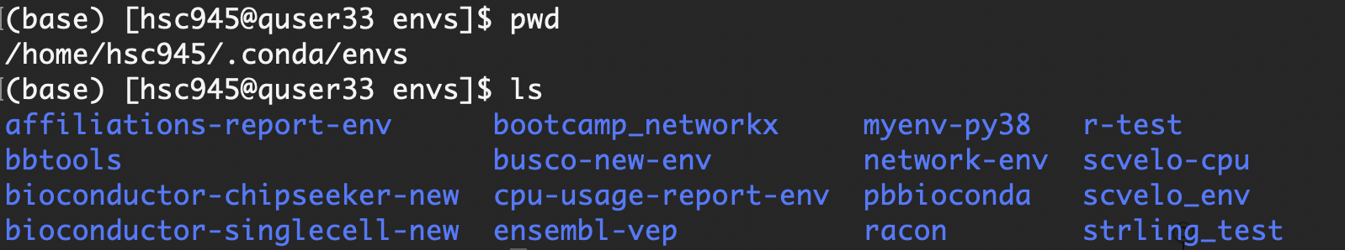
Creating a named virtual environment
mamba create –name networkx-env
# creates an environment named networkx-env

Slide 95
Installing software into a virtual environment
mamba activate numpy2
# moves you into the environment
mamba list
# lists what’s installed in your current environment

Slide 96
Installing software into a virtual environment
mamba install conda-forge::numpy
# install numpy and dependencies from conda-forge channel
# mamba install -c conda-forge numpy
# mamba install -c conda-forge numpy=1.26
# mamba create --name numpy2 conda-forge:numpy2

Slide 97
Installing Jupyter kernel into environment
mamba install ipykernel
# install ipykernel package into virtual environment
python -m ipykernel install --user --name numpy2 --display-name “Numpy2”
# create kernel to use this environment with Jupyter

Slide 98
Conda virtual environments
You can create both Python and R environments, and it’s a great package management system for that, but lots of other software can be installed via virtual environments too!
Check out conda-forge, bioconda, anaconda channels for available software
Github pages often mention if their software is availble via conda or Docker/Singularity

Slide 99
Singularity containers
House an isolated software environment, including OS, that can be easily shared through an image file
Doesn’t require admin permissions (to run)
Docker is a great option for non-HPC systems, but you can also use Docker images with Singularity on Quest
DockerHub, biocontainers, quay.io and other repositories

Slide 100
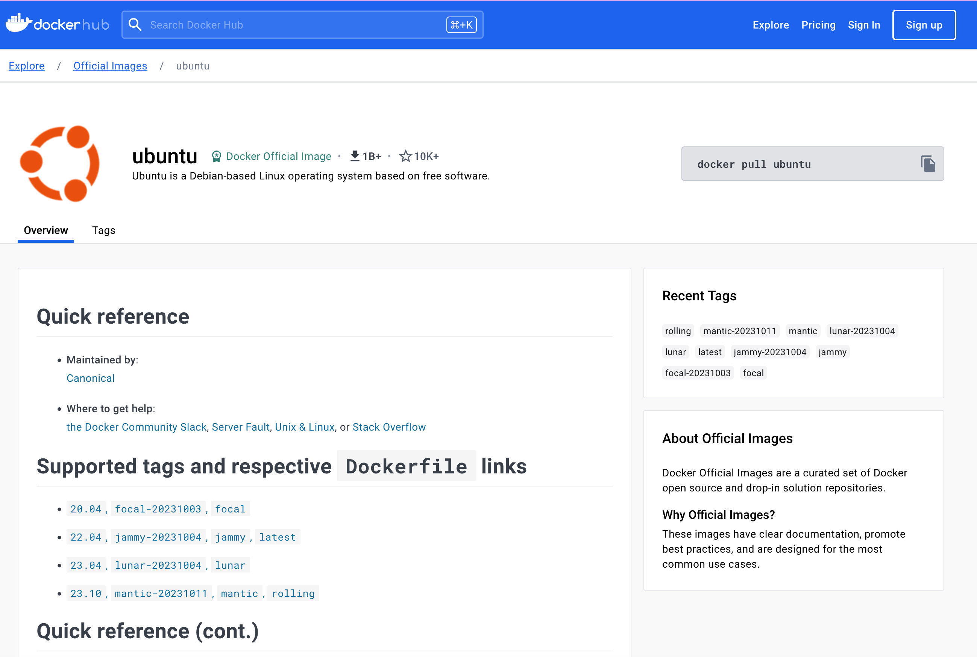
How To Obtain an Already Built Container
Download a container
singularity pull docker://ubuntu
Download a specific version
singularity pull docker://ubuntu:jammy
Note: you’ll need to load the module singularity on Quest

Slide 101
Exercise 9: Pull a container to Quest
Load the singularity/3.8.1 module.
Make sure you’re in your named directory (or home).
Pull the container for EnTAP using:
singularity pull docker://plantgenomics/easel:entap

Slide 102
Using a Container: singularity shell
Aside from the access to the local or host filesystem, singularity shell is like logging into and using a completely different computer.
Almost all programs and software in the container will be different than that of your host system, even programs that live in the same location.
## ‘outside’ container ##
[quser31 part1]$ grep --version
grep (GNU grep) 2.20
[quser31 part1]$ cat /etc/redhat-release
Red Hat Enterprise Linux Server release 7.9 (Maipo)
## ‘inside’ container ##
[quser31 part1]$ singularity shell ubuntu_jammy.sif
Singularity> grep --version
grep (GNU grep) 3.7
Singularity> cat /etc/os-release
PRETTY_NAME="Ubuntu 22.04.4 LTS"
...
VERSION="22.04.4 LTS (Jammy Jellyfish)"

Slide 103
Using a Container: singularity exec
singularity exec is very much akin to running a command on a remote machine using ssh.
With ssh you can run a given command on a remote computer
## ‘outside’ container ##
[quser31 part1]$ grep --version
grep (GNU grep) 2.20
## ‘inside’ container ##
[quser31 part1]$ singularity exec ubuntu_jammy.sif grep --version
grep (GNU grep) 3.7
[quser31 part1]$

Slide 104
Exercise 9: Use a container on Quest
(Load the singularity/3.8.1 module.)
Make sure you’re in your named directory (or home).
Enter the container for EnTAP using:
singularity shell -B /projects easel_entap.sif
Enter the EnTAP command to see the help menu:
EnTAP

Slide 105
What would a job script look like with a container?
!#/bin/bash
#SBATCH --account e32431
#SBATCH --partition short
#SBATCH --time 00:10:00
module puge
module load singularity/3.8.1
singularity exec -B /projects easel_entap.sif EnTAP

Slide 106
Quest 101: Supercomputing at Northwestern
What is Quest?
What resources are available?
How do I get access?
How do I log on?
How do I navigate the file system and where should I store things?
Command line tutorial
Software modules available on Quest
Submitting jobs
writing a job script
interactive jobs

Slide 107
Quest 101: Supercomputing at Northwestern
Browser-based options for interacting with Quest
Quest OnDemand
Quest Analytics Nodes
What if the software I need isn’t already a module?
Conda virtual environments
Docker and singularity containers
Time for questions

